Slide 1

Network Routing Protocol using Genetic Algorithms and comparing with Dijkstra algorithm
Supervisor: Dr.Kweh Yeah Lun
Committee:DR. Zurina Binti Mohd Hanapi
BY:
Nasrin Eshraghi Ivari GS31834

Slide 2

Outline
Part l:
Introduction
Part ll:
literature Review
Part lll:
-Research Methodology
-Proposed solution
Part IV:
-Results
-Conclusion
-References

Slide 3

Anchor Paper
Gihan Nagib and Wahied G. Ali . “Network Routing Protocol using Genetic Algorithms”. International Journal of Electrical & Computer Sciences IJECS-IJENS.(2010)

Slide 4
Introduction
Research Motivation
The performance and reliability of the Internet depend in large part on the operation of the underlying routing protocols. Today's IP routing protocols compute paths based on the network topology and configuration parameters, without regard to the current traffic load on the routers and links.
growing traffic cause localized link congestions, routing optimization can be used to resolve or at least soften potential network performance problems.
Routing is a process of transferring packets from source node to destination node with minimum cost .

Slide 5
Different techniques have been used for solving the SPF problem, some of them being Dijkstra Algorithm, Floyd Algorithm, ant colony optimization, Genetic Algorithm, Tabu Search etc. The choice of algorithm for any specific problem depends upon the complex tradeoffs between complexity, performance…
Router decides which neighbor to choose from routing table to reach specific destination.
Dijkstra's Algorithm
Genetic Algorithm

Slide 6
Introduction
Problem Statement
What if routing becomes overloaded or congestion happened on a link in the path? The packets will not arrive to the desired destination or may be delayed, a lot of queuing and processing on the routers and less service quality.
traffic in network cause decreasing the available bandwidth and speed which lead to congestion problem in network .and this congestion leads to decreasing total network throughput.
Find the path of minimum total length between two given nodes.

Slide 7
Introduction
In this research my main objective is to achieve high performance in large networks effected by cost factors which includes router network throughput of a link or link availability and reliability.
Utilizing Genetic Algorithm To find the path with the minimum total cost (SP) between source node and destination node (shortest path) For improving network performance and find the optimal destination for routing.
Compare Genetic algorithm with Dijkstra .
Objective

Slide 8
Introduction Scope
Routing to transfer packets from source to destination node in wire , wireless, cellular networks. My focus is on LAN networks.
sing programming language like C# and MATLAB to implement.
new routing protocol proposed based on artificial intelligence algorithms for finding shortest path between nodes in network.

Slide 9
Dijkstra algorithm
Introduction
Conceived by Dutch computer scientist Edsger Dijkstra in 1959
is a graph search algorithm that solves the single-source shortest path problem for a graph with non-negative edge path costs, producing a shortest path tree.
This algorithm is time consuming, when the network is too big or huge amount of traffic
For a given source vertex (node) in the graph, the algorithm finds the path with lowest cost (i.e. the shortest path) between that vertex and every other vertex.
This algorithm divides nodes in to sets : tentative and permanent .
Dijkstra Algorithm is widely used because of its simplicity. It is based on bellman optimization theory.

Slide 10
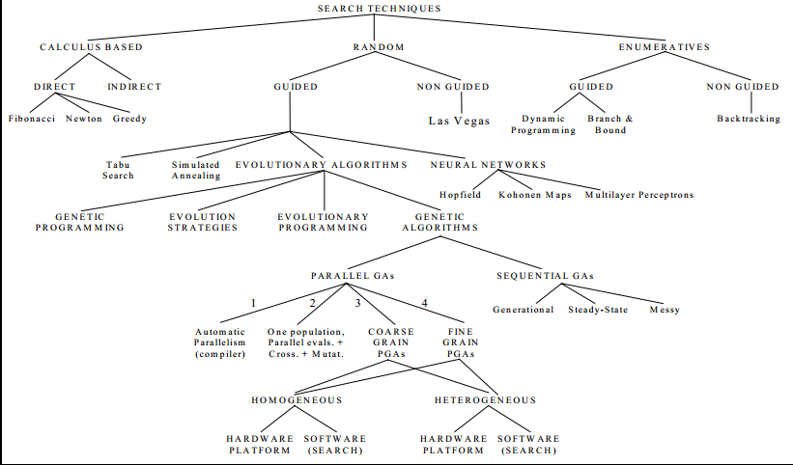

Slide 11
Introduction
Genetic algorithms (GAs) are global search and random optimization techniques modeled from natural selection, genetic and evolution that first published by John Holland-1975.
A genetic algorithm maintains a population of candidate solutions, where each candidate solution is usually coded as binary string called a chromosome.
A set of chromosomes forms a population, which is evaluated and ranked by fitness evaluation function. It is play a critical role in GAs because it provides information how good each candidate.
The evolution from one generation to the next one involves mainly three steps: fitness evaluation, selection and reproduction
Genetic Algorithm

Slide 12
Evolution of generation in Genetic Algorithm
Mutation
Crossover
Evaluation (fitness)

Slide 13
the current population is evaluated using the fitness evolution function and then ranked based on their fitness. A new generation is created with the goal of improving the fitness. GA uses three operators with probabilistic rules: reproduction, crossover and mutation. First selective reproduction is applied to the current population so that the string makes a number of copies proportional to their own fitness. This results in an intermediate population.
GA select "parents" from the current population with a bias that better chromosome are likely to be selected. This is accomplished by the fitness value or ranking of a chromosome.
GA reproduces "children" (new strings) from selected parents using crossover and/or mutation operators.

Slide 14
Literature Review
Title of paper | Year and Publication | method | Advantage | Description | problem | # | Result of implimentTIon
QoS Routing Protocol Using GA’s | 2011 International Journal of Science and Advanced Technology | QoSRGA protocol used the suggested metric RQoSR to evaluate the value of routes and applied GA operators as an intelligent tool to select a high quality and fast decision routing solution. | The proposed algorithm is good at selecting the best routes with a higher RQoSR | network QoS is characterized with multiple metrics such as available bandwidth, delay jitters, loss rate, authentication, security, and admissibility sustainment | is encoding a path into a chromosome | 1 | the average fitness of the population increases at each iteration, so by repeating the process for many iterations, better results are discovered
Exploring Genetic Algorithm for Shortest Path Optimization in Data Networks | 2010 Global Journal of Computer Science and Technology | have implemented a Genetic algorithm to finds the set of optimal routes to send the traffic from source to destination -Deal with PMX crossover | GA is well suited for solving problems where the solution space is huge and time taken to search exhaustively is very high | PMX crossover use in this paperis Partially Matched Crossover, two strings are aligned, and two crossover points are selected uniformly at random along the length of the strings | ISPs are trying to meet the increasing traffic demand with improved utilization of existing resources and application of new technologies | 2 | GA performs well in problems with complex fitness. If the function is discontinuous, noisy, changes over time or has many local optima, then GA gives better results

Slide 15
Literature Review
A Dynamic Routing Control Based on a Genetic Algorithm | 1993 IEEE | Proposed a routing control based on a Genetic Algorithm. By using the configuration string whose element represents a path between nodes, we can obtain a solution that meets the loss- rate requirements after relatively few generations | The proposed method is useful for dynamic routing control during traffic fluctuations, and it can be extended to such network problems as network design and virtual-path control in B-ISDN networks. | The number of searching iterations has been decreased by using the past routing patterns as a part of the initial data for new searches. | The problem with state-dependent method is that finding satisfactory solutions requires a huge amount of calculation power. | 3 | In simulation, the control target and assumptions were similar to and the demanded traffic was changed periodically with some fluctuations.
Genetic Algorithm Finding the Shortest Path in Networks | 2008 | This algorithm selects two individuals from the population with the lowest costs. |  |  | problem of optimizing OSPF weights, given a set of projected demands, with the objective of minimizing network congestion. The weight assignment problem is NP-hard | 4 | The results show that GA gets close to optimum very quickly. This is a promising result for his research.

Slide 16
Literature Review
BIONOMIC ALGORITHM FOR SHORTEST PATH FIRST | 2005 Journal of Theoretical and Applied Information Technology | structure of BA makes it suitable for combinatorial optimization problems whereas GA hardly describes properties of the solution, also the Evolutionary Strategy is will adapted because it works on continuous spaces | BA algorithm has certain advantages over Dijkstra algorithm and other evolutionary algorithms, like it caters better for avoiding local optima. | The shortest path finding problem can be efficiently solved using bionomic algorithm which has already been used successfully for solving some other optimization and searching problems. | The shortest path finding problem . optimization and searching problems. | 5 | Dijkstra’s algorithm is not concerned with an optimum solution, it rather finds the best path by any mean. As mentioned earlier that BA follows the GA framework for the most part; this implies that basic parameters will be the same as for GA
ROUTING USING GENETIC ALGORITHM FOR LARGE NETWORKS | 2010 Diyala Journal of Engineering Sciences | Using genetic algorithm for solving the shortest path routing problem. The reproduction, crossover and the mutation operations work on variable-length chromosomes. | propose a detailed genetic algorithm in order to optimize routing tables and to enhance the performance of the routers. | Step1: Generate the graph with cost for each path. Initialize the global variables and the population Step2: Choose the source and destination node to generate all the paths between the desired nodes. Step3: Calculate the fitness of all the paths generated in the previous step | routing optimization in large networks | 6 | First use the Dijkstra but if the path takes long time to deliver the packets because of overloading immediately use the genetic algorithm.

Slide 17
Literature Review
A Genetic Algorithm for Shortest Path Routing Problem and the Sizing of Populations | 2002 IEEE TRANSACTIONS ON EVOLUTIONARY COMPUTATION | presents genetic algorithmic approach to the shortest path routing problem. Variable-length chromosomes and their genes |  |  | shortest path (SP) routing problem encoding the gene problem | 7

Slide 18
Literature Review
Research | Method | Advantage | Sensible
Most Research on Dijstra ‘s algorithm | The Dijkstra algorithm is considered as the most efficient method for shortest path computation in IP networks. But when the network is very big, then it becomes inefficient since a lot of computations need to be repeated(if the path takes long time to deliver the packets because of overloading immediately). Also it cannot be implemented in the permitted time.
Exploring Genetic Algorithm for Shortest Path Optimization in Data Networks 2010 | Genetic algorithm | send the traffic from source to destination | GA is well suited for solving problems where the solution space is huge and time taken to search exhaustively is very high.
routing using genetic algorithm for large Networks 2010 | Variable-length chromosomes (strings) and their genes have been used for encoding the problem | The proposed algorithm can cure all the infeasible chromosomes with a simple repair function. Crossover and mutation together provide a search capability that results in improved quality of solution and enhanced rate of convergence. | try to find a way to optimize the network based on other parameters rather than the cost to give the chance to find all the better solutions.

Slide 19
Literature Review
Research | Method | Advantage | Sensible
Genetic Algorithm Finding the Shortest Path in Networks 2006 | The weight assignment problem is NP-hard. developed a genetic algorithm (GA) to solve this Problem | the network is very big, then Dijkstra becomes inefficient since a lot of computations need to be repeated. Also it can not be implemented in the permitted time | test my GA algorithm on some real network topologies containing much more nodes and links
QoS Routing Protocol Using GA’s 2001 | finding a feasible path and apply genetic algorithms QOS also included | Use RQoSR to evaluate the value of routes and applied GA operators as an intelligent tool to select a high quality and fast decision routing solution. | The most critical task for developing GA to this problem is encoding a path into a chromosome. The evaluation function is carried out using a Reduced QoS for Routing metric(RQoSR).

Slide 20
Literature Review
Parameters | Genetic Algorithm
Functionality | Genetic Algorithm belongs to a family of computational models inspired by evolution. These algorithms encode a potential solution to a specific problem on a simple chromosome-like data structure and apply recombination operators to these structures as to preserve critical information
Performance | Genetic Algorithm are faster than the hill climbing as it implements implicit parallelism wherein each new string is completely independent of the previous one, so each new string is given independently to the new schema region.
Representation | Bit-String representation is critical
Multi-dimensional solving | Supports the muilti-dimentional approach
Technique preferred | Global Optimum
Distribution of population is diverse and large | GA makes a large, useful and structured jump even after partial convergence.
Least diverse population | GA does not gain benefit in least diverse population.
Search Mechanism | GA performs a multi-directional search by maintaining a population of potential solution and encourages information exchange between these directions.
Examples | Acoustics, Aerospace engineering, Astronomy and astrophysics, Chemistry, Electrical engineering, Financial markets, Game playing, Geophysics, Materials engineering.

Slide 21
Literature Review
Genetic Algorithm | Dijkstra algorithm
GA is difficult to implement and also its running time is greater than that of Dijkstra algorithm and it increases with an increase in the size of the network. But, GA provides multiple optimum candidate solutions with optimized paths (as opposed to Dijkstra algorithm which gives only one solution, though the best one, if it becomes unavailable somehow, we don’t have any second option and we get stuck right there); this makes GA a promising algorithm which can be used with other algorithms in different applications Parallel in nature | Dijkstra Algorithm is widely used because of its simplicity. It is based on bellman optimization theory. It finds the shortest path from the source node to all other nodes in the network, for which it requires global topological knowledge of the network
Because only primitive procedures like "cut" and "exchange" of strings are used for generating new genes from old, it is easy to handle large problems simply by using long strings, | It computes the shortest path as a function of distance, cost, traffic etc.
One major concern when applying GA for solving such problem is how to encode a path in a graph into chromosomes. Here, priority based encoding scheme is used. | One major drawback of Dijkstra algorithm is that it consumes more processing time (computation cost) if network is large
Because the genetic operations are performed at random and also include mutation, it is possible to avoid being trapped by local-optima. Communication networks present large-scale optimization problems with various kinds of objective functions, and Genetic Algorithms should be suitable for such problems. | Cost calculate each level by level (not known from first step)
Suited for solving problems where the solution is huge and time taken to search is very huge | Calculate positive weight

Slide 22
S/NO | ENCODING TECHNIQUE | EXAMPLE
1 | Binary Encoding | Chromosome 1: 101100101100101011100101 Chromosome 2: 111111100000110000011111
2 | Permutation Encoding | Chromosome 1: 7 6 5 4 8 3 9 0 1 Chromosome 2: 2 3 4 5 7 5 3 0 8
3 | Value Encoding | Chromosome 1: 3.6556 1.4560 7.4578 3.7654 9.0987 Chromosome 2: ASDFGHJIKOYTGHSIDRUWSDJ Chromosome 3: (right), (back), (left), (back), (forward)
4 | Tree Encoding | (+X(/5Y)) (Do until Step Wall)
+
Do Until
X
/\
5
Y
Step
Wall

Slide 23
S/NO | Encoding Technique | Crossover Technique | Example
1 | Binary | 1. single cut point crossover | 1100/1011+1101/1111= 1100/1111 + 1101/1011
 |  | 2. Double cut point | 11/00/1011+11/01/1111 = 11011011 +11001111
 |  | 3. Uniform crossover | 11/00/1011+11/01/1111 = 11011011 +11001111
 |  | 4. Arithmetic crossover | 0100110 + 0100101 = 1100110 + 0101111 (the first three digits of each parent are added together for child 1 and the remaining digits are added for the child 2)
2 | Permutation encoding | Single Cut Point | (1 2 3 4 5 6 /7 8 9) + (4 5 3 6 8 9/ 7 2 1) = (1 2 3 4 5 6 8 9 7) +4 5 3 6 8 9 7 1 2
3 | Real Value Encoding | Same as in Binary value | (1.29 5.68/ 2.86 4.11 5.55)+(3.23 4.45/ 6.13 5.67 2.98) = (1.29 5.68 6.13 5.67 2.98) +(3.23 4.45 2.86 4.11 5.55)--single point
4 | Tree Encoding | Exchange

Slide 24
S/NO | Encoding Technique | Mutation Technique | Example
1 | Binary | Bit inversion | 11001001 => 10001001
2 | Permutation | Change in order | (1 2 3 4 5 6 8 9 7) => (1 8 3 4 5 6 2 9 7)
3 | Real value | Addition of a small number | (1.29 2.86 5.68 4.11 5.55) => (1.29 2.86 5.68 4.22 5.55)
4 | Tree | Change in operator

Slide 25
Methodology
Research Framework
Literature Review
Utilizing GA routing algorithm
Utilizing Dijkstra Algorithm
Programming and Simulating
Experimental Setup, Analysis
Finding Results

Slide 26
Methodology
1- Dijkstra algorithm

Slide 27
Topology of Dijkstra algorithm
∞
14
9
5
6
6
2
9
?
14
3
11
4
22
9
1
10
1
15
0
2
7
7

Slide 28
Methodology
2- Genetic Algorithm
Performance parameters
The metric of optimization is the cost of path between the nodes. The total cost is the sum of cost of individual hops.
Feasible path
Chromosomes length

Slide 29
Flowchart of methodology

Slide 30
Proposed Method
At the beginning a random population of strings is generated which represents admissible (feasible) or un-admissible (unfeasible) solutions.
Un-admissible (unfeasible) solutions are strings that cannot reach the destination. That means, the string solution would lead to a path without link between nodes (zero fitness).
Admissible (feasible) solutions are strings that can reach the target.

Slide 31
nod1
Network Topology
15
10
n2
3
n3
8
9
n4
5
n5
7
2
6
n6
n7
10
12
n9
10
n8
8
6
n10

Slide 32
Proposed Method
Chromosomes and Initialization
A chromosome corresponds to possible solution of the optimization problem. Thus each chromosome represents a path which consists of a set of nodes to complete the feasible solution.
as the sequence of nodes with the source node followed by intermediate nodes (via nodes), and the last node indicating the destination, which is the goal.
initial population of chromosomes can be randomly generated such that each chromosome has a random genes (via nodes).

Slide 33
Proposed Method chromosome structure
0001 0011 0101 …
The default maximum chromosome length is equal to the number of nodes times the gene length (4-bit binary code/gene). The network has 10 points where each point is coded in 4 binary bits. That means; the chromosome length is equal to 10X4=40 bits.
3th Gene
1th Gene
2th Gene

Slide 34
first, let us consider different paths from the source Node to the destination node (Initial population) :
Parent path 1: 1-3-5-7-9-10
Parent path 2: 1-2-4-7-9-8-10
Parent path 3: 1-2-4-6-8-10
Parent path 4: 1-2-3-5-6-8-10

Slide 35
Proposed Method
Secondly, the paths are encoded using binary numbers where each node is encoded by 4-bits, as shown in table below,
Node | Binary Code | Linked Nodes
1 | 0001 | 2,3
2 | 0010 | 3,4
3 | 0011 | 5
4 | 0100 | 6,7
5 | 0101 | 6,7
6 | 0110 | 8
7 | 0111 | 9
8 | 1000 | 10
9 | 1001 | 8,10
10 | 1010 | destination

Slide 36
Thirdly, made chromosomes according to the parent paths, where, each number is represented by its corresponding binary bits (Decode) :
Chromosome A: 0001 0011 0101 0111 1001 1010
Chromosome B: 0001 0010 0100 0111 1001 1000 1010
Chromosome C: 0001 0010 0100 0110 1000 1010
Chromosome D: 0001 0010 0011 0101 0110 1000 1010

Slide 37
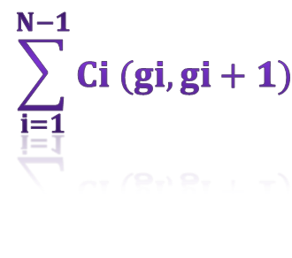
Proposed Method
Evaluation (performance metric)
The evaluation function of a chromosome measures the objective cost function.
Since the fitness should increase as the cost decreases.
F=
1
$$\sum_{i=1}^{N−1}{Ci (gi, gi+1)}$$
Feasible Path (survival)
0
Infeasible Path (died)

Slide 38
Now, according to the fitness function, we calculate the cost of that path.
E.g., the parent path 1 is (1-3-5-7-9-10),
so, its cost acc. To the fitness function is
Parent path 1: 1-3-5-7-9-10
10+9+2+10+8=39
String number | Initial population | Cost | Fitness value
1 | Chromosome A | 39 | 0.025
2 | Chromosome B | 54 | 0.018
3 | Chromosome C | 48 | 0.020
4 | Chromosome D | 51 | 0.019

Slide 39
Proposed Method
Operators
The algorithm uses the common two genetic operators:
crossover
mutation
Crossover recombines two 'parent' paths to produce two 'children' new paths in the next generation. During the crossover, a string that has an efficient fitness is randomly selected as a parent. If the second parent contains the common number in the first one; both strings exchange the part of their strings following the common number. If not another string is selected as the second parent and the same procedure is followed.
The mutation process is also applied to flip randomly a bit position in the chromosome. The main aim of carrying out mutation is to induce a certain level of diversity into population so that GA can be prevented from getting trapped into a local optimum

Slide 40
Now, we have to perform Crossover, Before cross over :
Chromosome A: 0001 0011 0101 0111 1001 1010
Chromosome B: 0001 0010 0100 0111 1001 1000 1010
Chromosome C: 0001 0010 0100 0110 1000 1010
Chromosome D: 0001 0010 0011 0101 0110 1000 1010
So, the bits after crossover may be represented as:
Chromosome A: 0001 0011 0101 0111 1001 1010
Chromosome B: 0001 0010 0100 0111 1001 1000 1010
Chromosome C: 0001 0010 0100 0101 1000 1010
Chromosome D: 0001 0010 0011 0110 0110 1000 1010

Slide 41
Path after crossover
Chromosome A (PATH):1-3-5-7-9-10
Chromosome B (PATH):1-2-4-7-9-8-10
Chromosome C (PATH):1-2-4-5-8-10
Chromosome D (PATH):1-2-3-6-6-8-10
String number | Initial population | Cost | Fitness value
1 | Chromosome A | 39 | 0.025
2 | Chromosome B | 54 | 0.018
3 | Chromosome C | 0 | 0
4 | Chromosome D | 0 | 0

Slide 42
next step is to perform Mutation
Chromosome A: 0001 0011 0101 0110 1001 1010
Chromosome B: 0001 0010 0011 0111 1001 1000 1010
After :
Chromosome A: 0001 0011 0101 0111 1001 1010
Chromosome B: 0001 0010 0100 0111 1001 1000 1010

Slide 43
Proposed Method Components
Termination
This generational process is repeated until a termination condition has been reached. Common terminating conditions are:
convergence criteria are met
A solution is found that satisfies minimum criteria
Fixed number of generations reached
Allocated budget (computation time/money) reached
The highest ranking solution’s fitness is reaching or has reached a plateau such that successive iterations no longer produce better results

Slide 44
Implementation
It expected that the proposed approach give us shortest chromosome with optimal answer and minimum cost. It predicted that for the given problem the algorithm represent the depicted answer.
The probability of crossover was chosen as 70% and the mutation rate equal to 2.5%. The best results are obtained using two points of crossover.
I implemented this project in C# and MALLAB

Slide 45
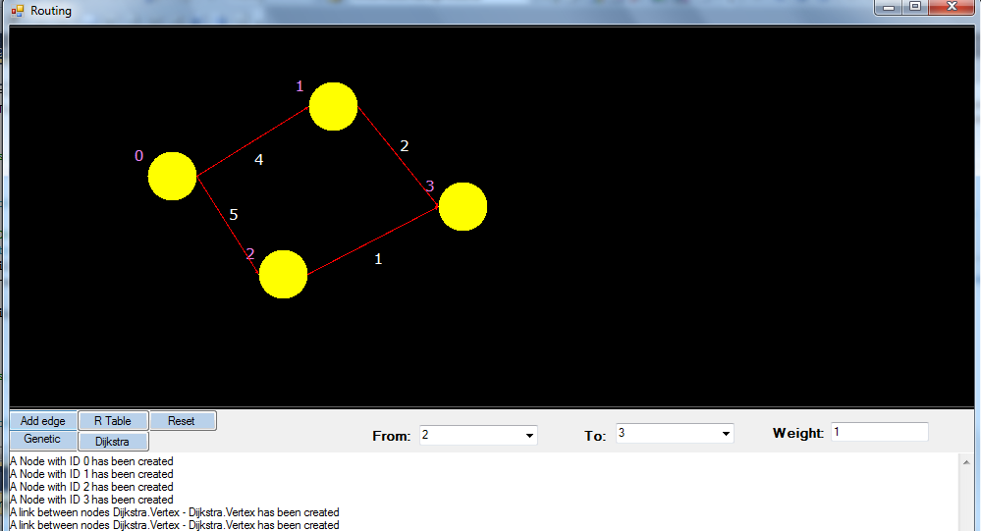
Snapshot of results

Slide 46
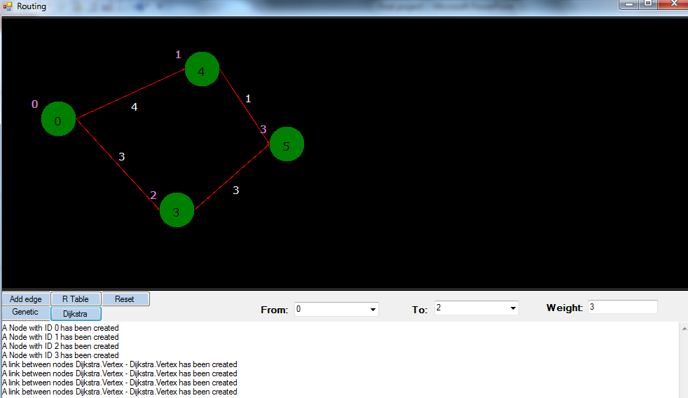
Snapshot of results

Slide 47
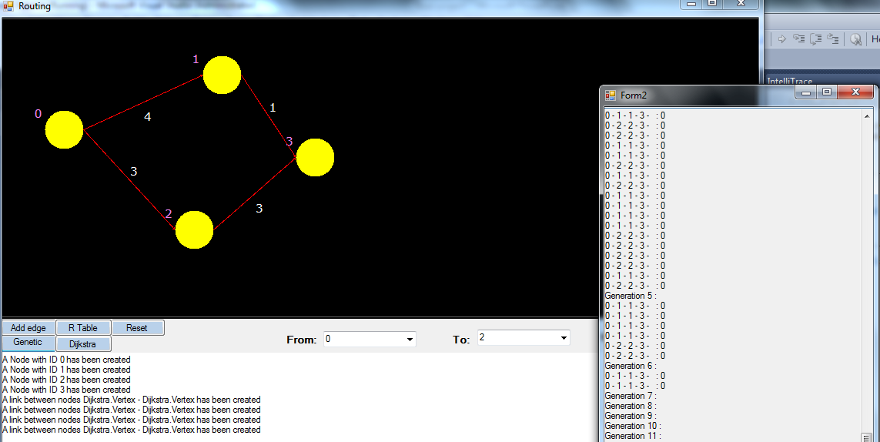
Snapshot of results

Slide 48

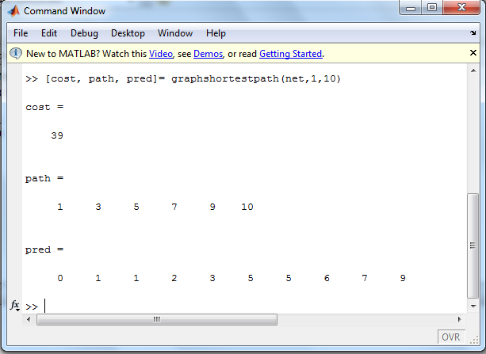

Slide 49

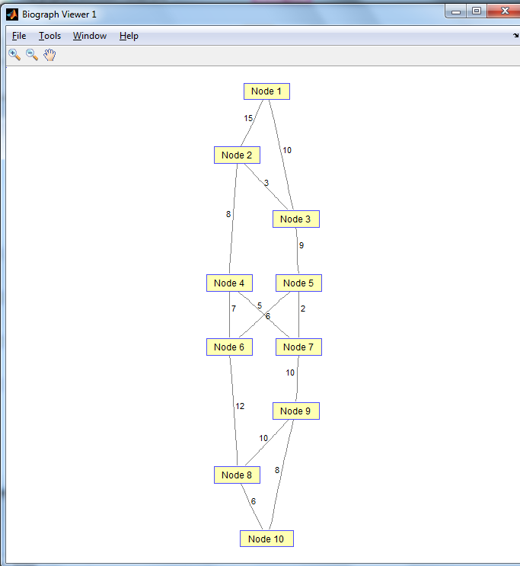

Slide 50
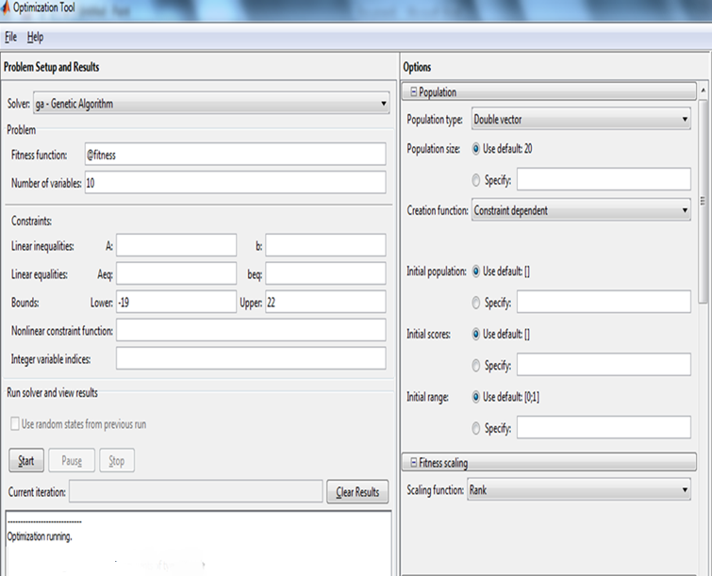

Slide 51
Conclusion
A simple genetic algorithm is developed to find the shortest path routing in a dynamic network. The developed algorithm uses an efficient coding scheme. The obtained results affirmed the potential of the proposed algorithm that gave the same results as Dijkstra's algorithm.
Because only primitive procedures like "cut" and "exchange" of strings are used for generating new genes from old, it is easy to handle large problems simply by using long.
It is anticipated that genetic algorithm GA can efficiently and dynamically give consistent better solutions regardless of: The network topology, The change in the network, removing any node, or link from the network, The volume of the network (if there are many paths).
Beside of GA, Dijkstra also working well for routing. But one main drawback of this algorithm is that time consuming more in huge networks.

Slide 52
Future scope
I envision the outcomes of this research go beyond local aspects and also become relevant from a distributed point of view because of the efficiency of the genetic algorithm to solve many problems in any field.
the developed GA will be more investigated to decrease the chromosome length especially for network with a large number of nodes.

Slide 53

References
Biswas, P., Mishra, P. K., & Mahanti, N. C. (2005). COMPUTATIONAL EFFICIENCY OF OPTIMIZED SHORTEST PATH ALGORITHMS. International Journal of Computer Science & Applications, II(Ii), 22–37.
Bryant, K. (2000). Genetic Algorithms and the Traveling Salesman Problem by Kylie Bryant.
De Jong, K. A. (1975, September 19). Analysis of the behavior of a class of genetic adaptive systems. University of Michigan, Ann Arbor. Retrieved from http://link.springer.com/10.1007/s11276-009-0208-8
Dijkstra, E. W. (1959). A Note on Two Problems in Connexion with Graphs. Numerische Mathematik 1, (l 959), 269–271.
Forouzan, B. A. (2003). DATA COMMUNICATIONS AND NETWORKING. Tehran: McGraw-Hill.
Fredman, Michael Lawrence; Tarjan, R. E. (1984). Fibonacci heaps and their uses in improved network optimization algorithms. 25th Annual Symposium on Foundations of Computer Science (IEEE), 338–346.
Gass, S.I. and Harris, C. M. (1996). Encyclopedia of Operations Research and management Science (Vol. 79490888, p. 223).
Goldberg, D. E. (1989). Genetic Algorithms in Search,Optimization, and Machine Learning (p. 412). Addison-Wesley.
Holland, J. H. (1975). Adaptation in Natural and Artificial Systems. (A. Arbor, Ed.). MI, The University of Michigan Press.
Hwang, R.-H., Do, W.-Y., & Yang, S.-C. (2000). Multicast routing based on genetic algorithms. J. Inf. Sci. Eng., 16(6), 885–901.
Moore, E. F. (1957). The shortest path through a maze, Proceedings of an International Symposium on the Theory of Switching (Harvard Un., pp. 285–292). Cambridge, Massachusetts.

Slide 54
Nagib, G., & Ali, W. G. (2010). Network routing protocol using Genetic Algorithms. International Journal of Electrical & Computer Sciences IJECS-IJENS, 10(02), 40–44.
Nor, S. M. (2007). Finding a Minimum Path Using Dijkstra ’ s Algorithm (1th ed.). Malaysia.
Pang, B., & Lee, L. (2008). Opinion Mining and Sentiment Analysis. (C. C. Aggarwal & C. Zhai, Eds.)Foundations and Trends® in Information Retrieval, 2(2), 1–135. doi:10.1561/1500000001
R, C.-D. (2000). World Survey of Genomics Research Funding, Interim Report. Switzerland, (2).
S.N.Sivanandam, S. N. D. (2008). Introduction to Genetic Algorithms (p. 453). Springer Berlin Heidelberg New York.
Simpson, B. A. R., & Dandy, G. C. (1995). Genetic algorithms compared to other techniques for pipe optimization, 120(4).
Sniedovich, M. (2006). Dijkstra ’ s algorithm revisited : the dynamic programming connexion by, 35(3), 87–92.
Srinivas, M., & Patnaik, L. M. (1994). Genetic algorithms: a survey. Computer, 27(6), 17–26. doi:10.1109/2.294849
Srinivas, Mandavilli, & Patnaik, L. M. (1994). Genetic algorithms: A survey. Computer, 27(6), 17–26.
T. H. Cormen, C. E. Leiserson, R. L. Rivest, and C. S. (2001). Dijkstra’s algorithm. Introduction to Algorithms (Second., pp. 595–601). MIT Press and McGraw-Hill.
Tannenbaum, A. S. (2008). Computer Networks. (Forth, Ed.) (p. 1123). india: Prentice-Hall of India.
Techniques, O. (n.d.). Genetic Algorithm.
Thengade, A. (2012). Genetic Algorithm – Survey Paper, 2012, 7–8.
Xiang, F., Junzhou, L., Jieyi, W., & Guanqun, G. (1999). QoS routing based on genetic algorithm. Computer communications, 22(15), 1392–1399.

Slide 55


Thank you for your attention

